Slide 1
Homework 1: FEM-1D
SCHOOL OF MECHANICAL AND AEROSPACE ENGINEERING
Doan Manh Hung
Oct 6th, 2014

Slide 2
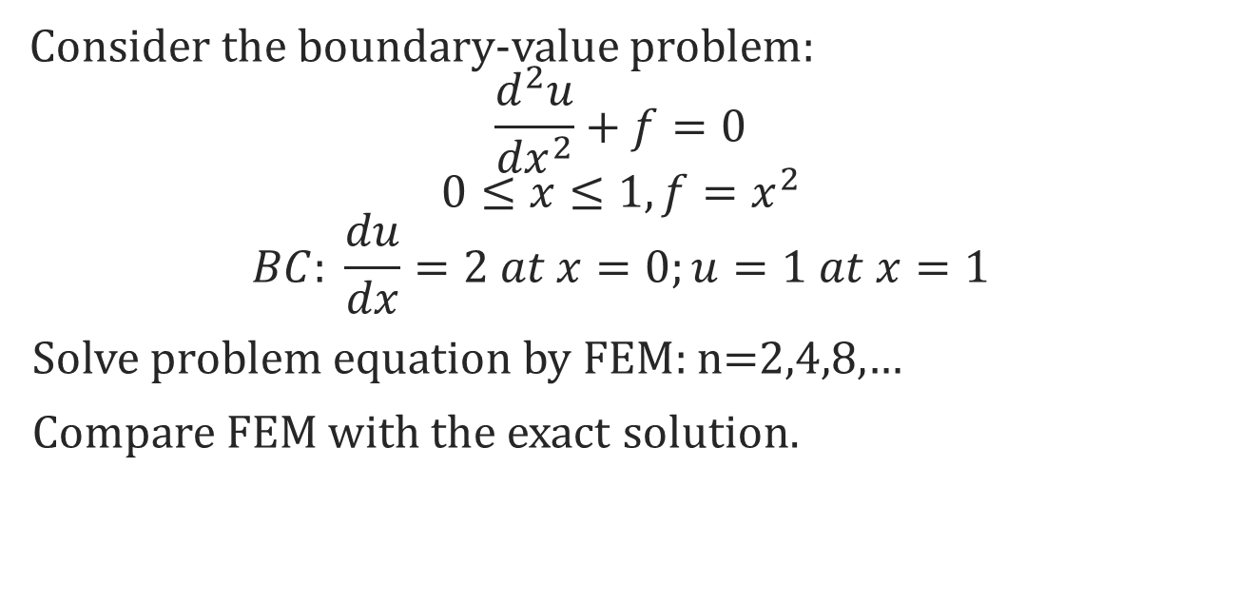
HW1:
Consider the boundary-value problem:
$$\frac{d^{2}u}{{dx}^{2}}+f=0$$
$$0≤x≤1, f=x^{2}$$
$$BC: \frac{du}{dx}=2 at x=0;u=1 at x=1$$
Solve problem equation by FEM: n=2,4,8,…
Compare FEM with the exact solution.

Slide 3





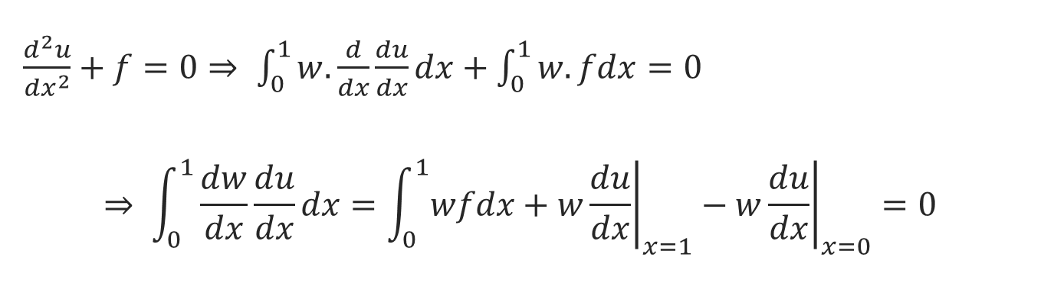


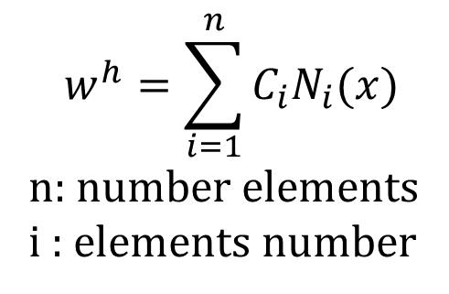



Solving problem
$\frac{d^{2}u}{{dx}^{2}}+f=0⇒ \int_{0}^{1}{w.\frac{d}{dx}\frac{du}{dx}dx+\int_{0}^{1}{w.fdx}}=0$
$$⇒ \int_{0}^{1}{\frac{dw}{dx}\frac{du}{dx}dx}=\int_{0}^{1}{wfdx}+{\left.w\frac{du}{dx}\right|}_{x=1}−{\left.w\frac{du}{dx}\right|}_{x=0}=0$$
$$w=0 at x=1$$
$$−2w at x=0$$
le
$$x_{1}$$
$$x_{2}$$
$$x_{3}$$
$$x_{4}$$
$$x_{i−1}$$
$$x_{i}$$
$$x_{n−1}$$
$$x_{n}$$
$$w^{h}=\sum_{i=1}^{n}{C_{i}N_{i}(x)}$$
n: number elements
i : elements number

Slide 4

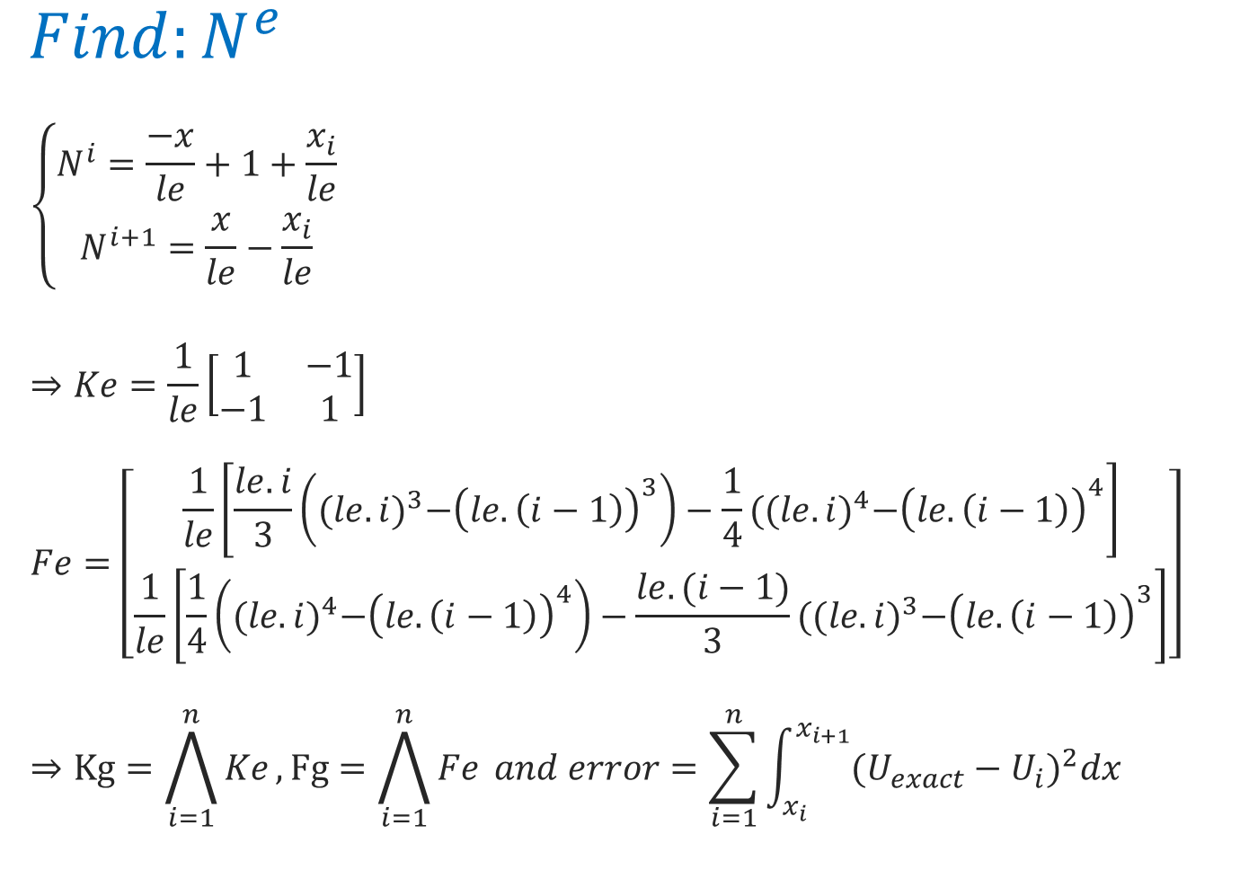



$$N^{i}$$
$$N^{i+1}$$
$Find:N^{e}$
$$\left\{\begin{aligned}N^{i}=\frac{−x}{le}+1+\frac{x_{i}}{le} \\ N^{i+1}=\frac{x}{le}−\frac{x_{i}}{le}\end{aligned}\right.$$
$$⇒Ke=\frac{1}{le}\left[\begin{matrix}1 & −1 \\ −1 & 1\end{matrix}\right]$$
$$Fe=\left[\begin{aligned}\frac{1}{le}\left[\frac{le.i}{3}\left({(le.i)}^{3}−{\left(le.\left(i−1\right)\right)}^{3}\right)−\frac{1}{4}({(le.i)}^{4}−{\left(le.\left(i−1\right)\right)}^{4}\right] \\ \frac{1}{le}\left[\frac{1}{4}\left({(le.i)}^{4}−{\left(le.\left(i−1\right)\right)}^{4}\right)−\frac{le.(i−1)}{3}({(le.i)}^{3}−{\left(le.\left(i−1\right)\right)}^{3}\right]\end{aligned}\right]$$
$$⇒Kg=\bigwedge_{i=1}^{n}{Ke}, Fg=\bigwedge_{i=1}^{n}{Fe} and error=\sum_{i=1}^{n}{\int_{x_{i}}^{x_{i+1}}{({U_{exact}−U_{i})}^{2}dx}}$$
$$x_{i}=\left(i−1\right)le$$
$$x_{i+1}=i.le$$

Slide 5

Exact solution
$$\frac{d^{2}u}{{dx}^{2}}+f=0$$
$0≤x≤1, f=x^{2}$
$BC: \frac{du}{dx}=2 at x=0;u=1 at x=1$
$$⇒y=−\frac{x^{4}}{12}+2.x−\frac{11}{12}$$

Slide 6
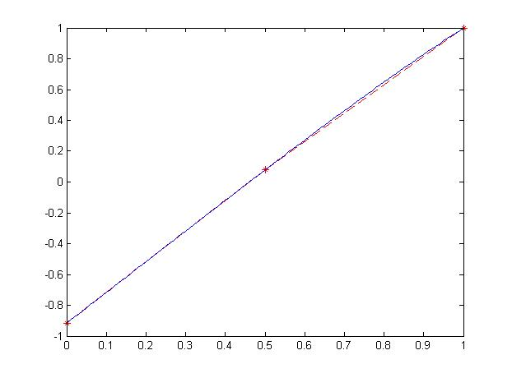
N=2
FEM: - -*- -
Exact: ------

Slide 7
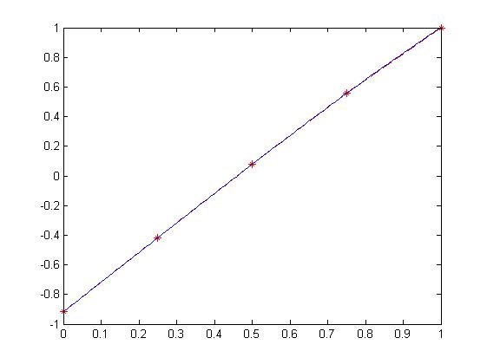
N=4
FEM: - -*- -
Exact: ------

Slide 8
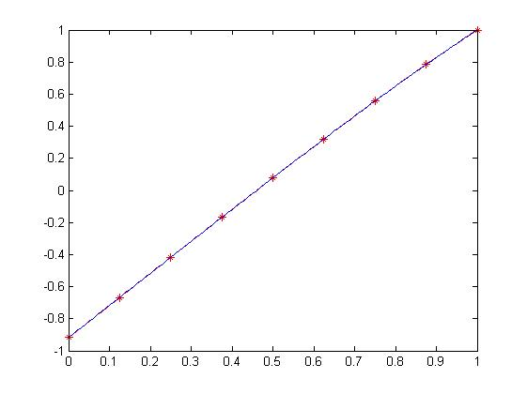
N=8
FEM: - -*- -
Exact: ------

Slide 9
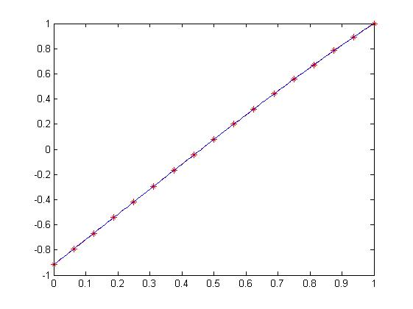
N=16
FEM: - -*- -
Exact: ------

Slide 10
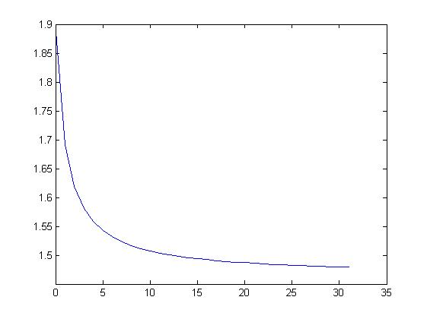
Error

Slide 11
Thank you for reading

